Slide 1
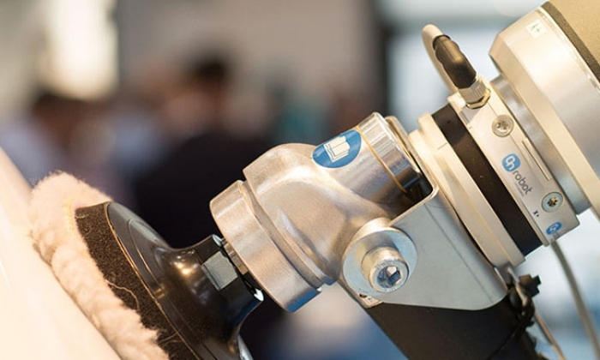
Precise Polishing Pressure in Points: Skill transfer using LfD for force relevant tasks
Group 6:
Mads Holm Peters
Jens Møller Rossen
Marcus la Cour Pedersen
Project Advisor:
Yitaek Kim
Source: https://onrobot.com/de/node/1489

Slide 2
Agenda
Why automate polishing?
(Maybe slide with flowchart)?
Creation of a general trajectory (LfD, GMM/GMR)
Estimation of contact area and force
Controlling the robot (hybrid force/position)
Results and future work
Questions

Slide 3
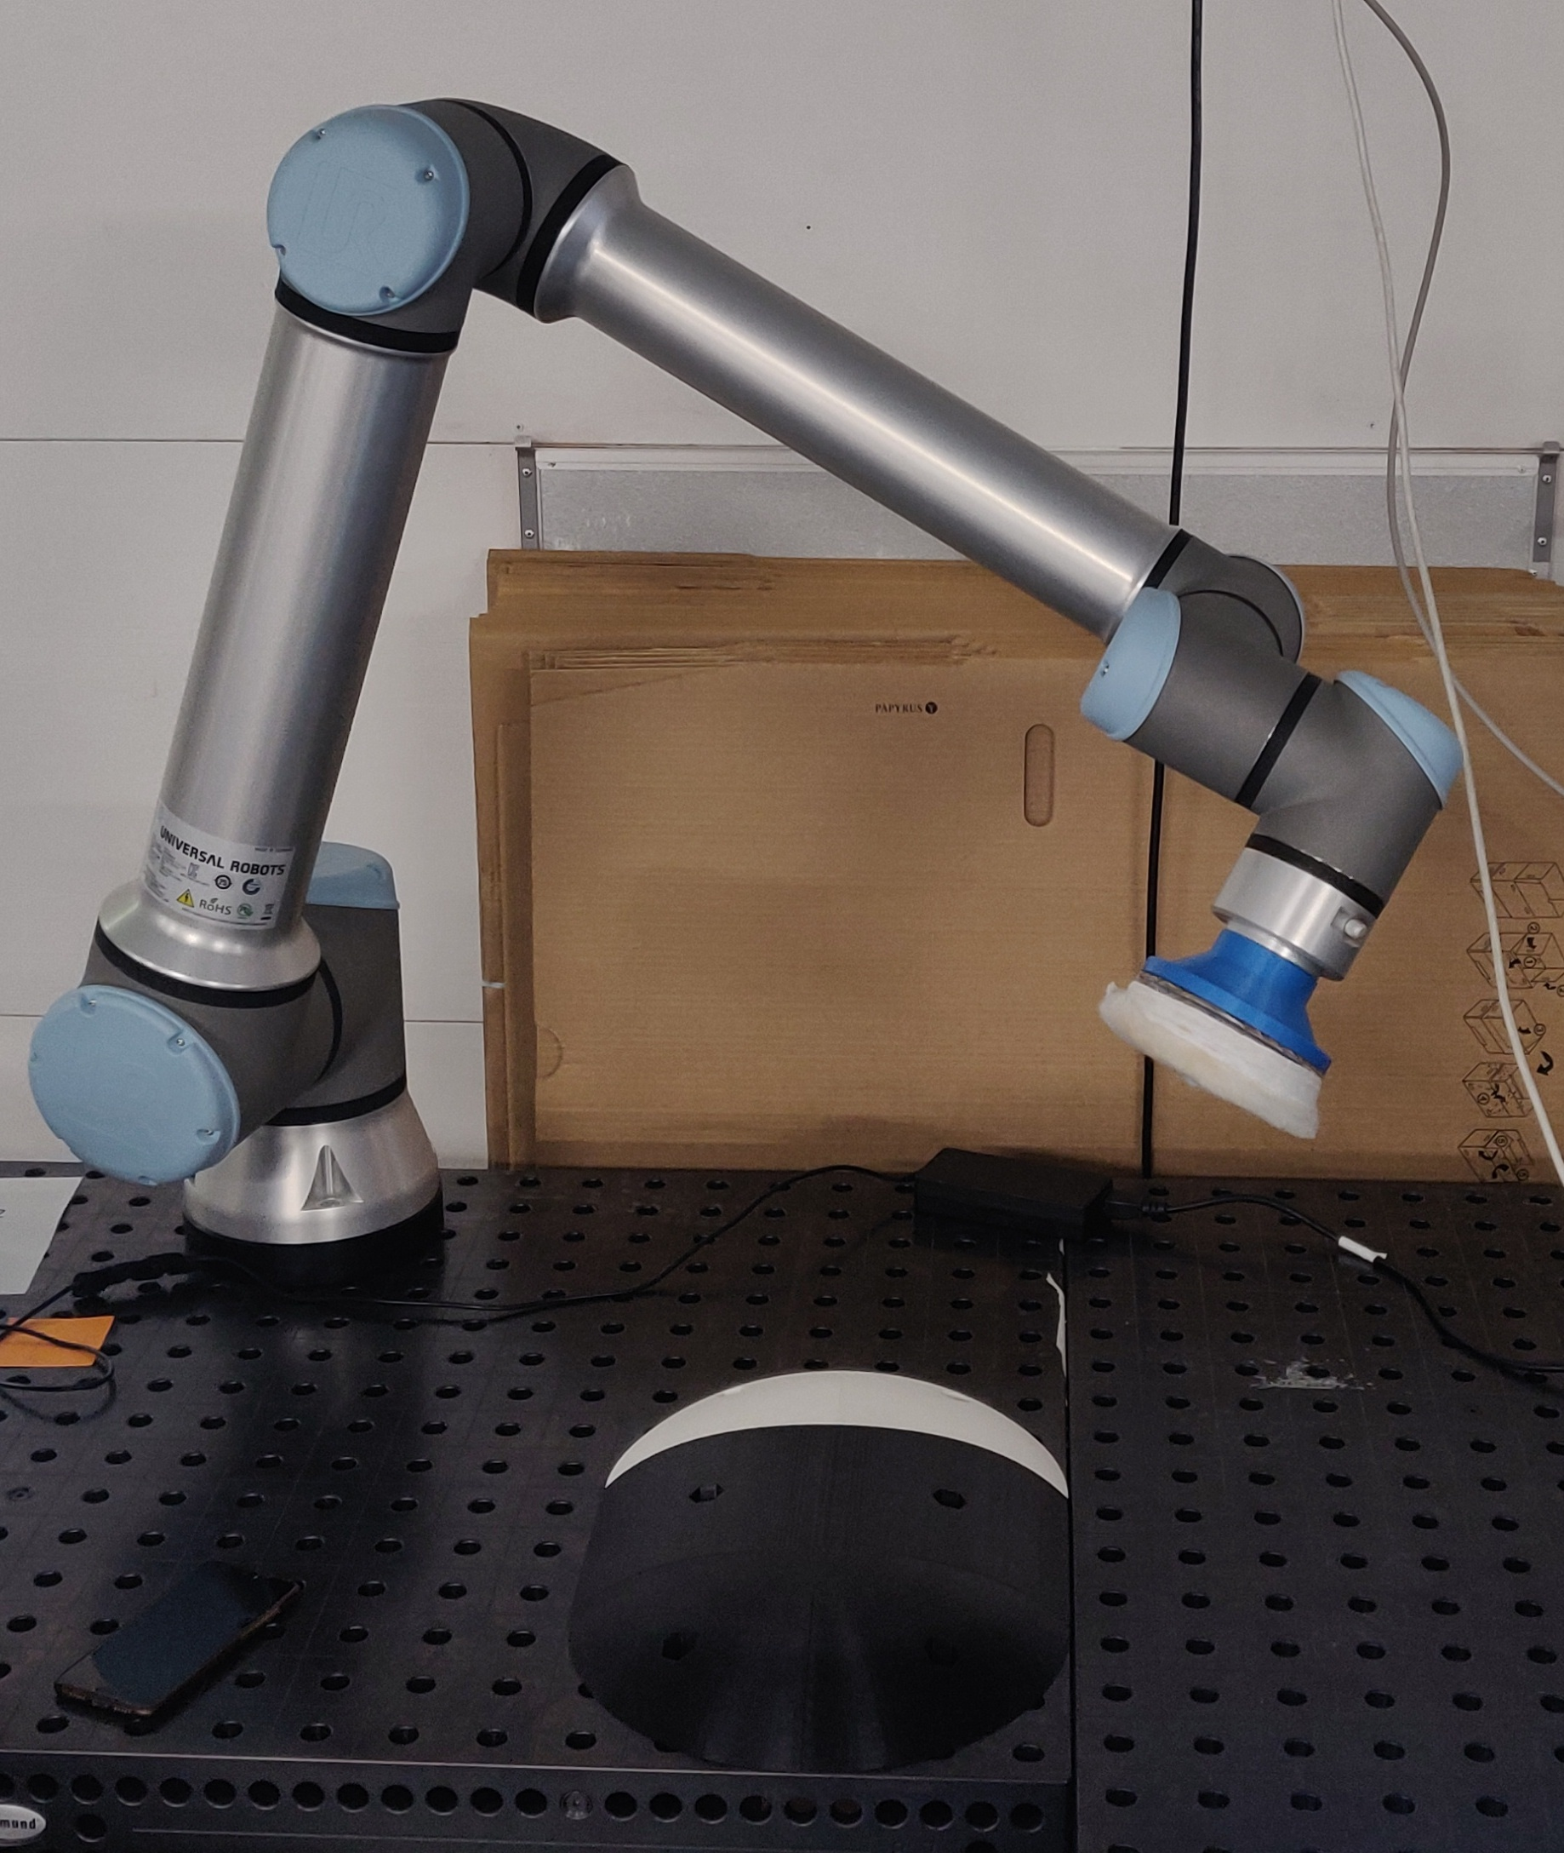
Why automate polishing?
Many force relevant tasks to choose from
Polishing – Constant pressure is desired along a trajectory
P = F / A . Hard to be consistent for a human
How can the general trajectory be obtained?
Encoding with LfD, generalising with GMM/GMR
How do we estimate the force to apply?
Estimation of contact area
How do we control the robot?
Keeping track of position, orientation and force

Slide 4
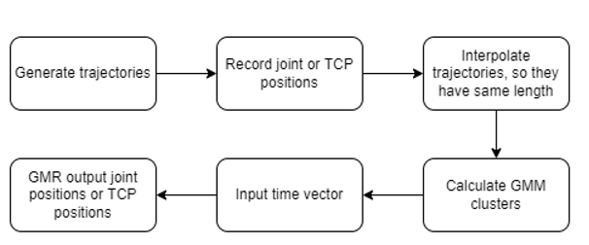
Creating a general trajectory (LfD, GMM/GMR)
Generate trajectories using free drive
Encoded using probabilistic model GMM/GMR
Problems with handling orientation
Forward kinematics

Slide 5
Show some results
Show graphs and maybe a video

Slide 6
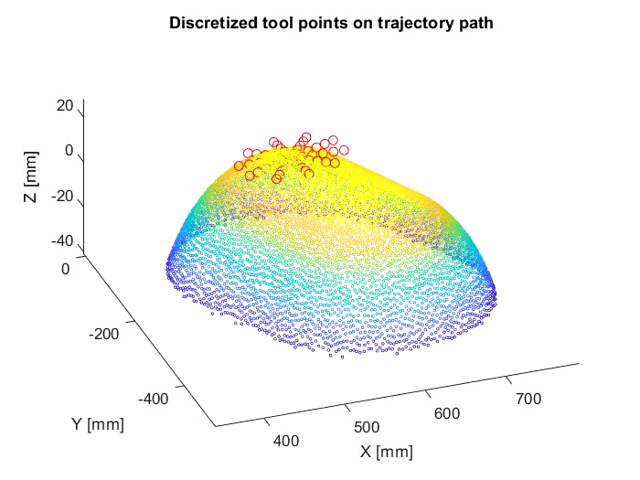
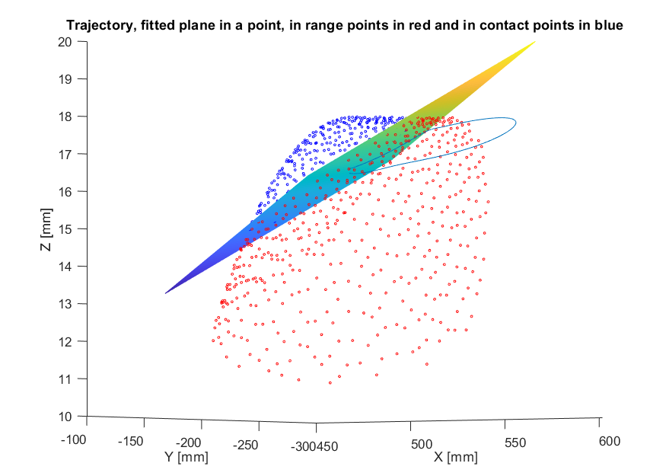
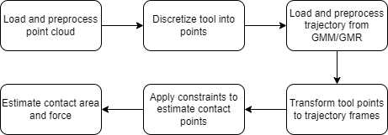
Estimation of contact area and force
CAD-model of the object -> point cloud
At first, a simple object was used
Development with randomly generated trajectories until real hardware access

Slide 7
Controlling the robot (Hybrid force/position)

Slide 8
Results and future work
Insert video
Modelling deformation in tool in contact area estimation
Improving handling of curvatures in objects

